Slide 1
Interaction
Digital tool: mentimeter
Strategy and Innovation Team
Directorate of Human and Robotic Exploration
15 March 2018

Slide 2
ESA Space 4.0i
Inform
Introduce the frame
Inspire
Propose the contents
Interact
Unlock creativity
Innovate
Meet the goals

Slide 3
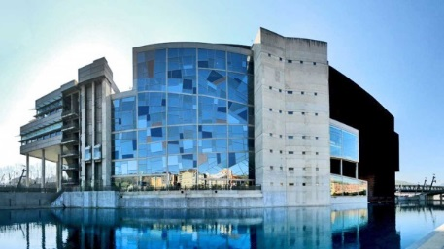
Space for Inspiration 2018
http://space4inspiration.esa.int/
To unlock the business valuable cross-sectional collaborations
To explore the potentials for technology advancements
To succeed in getting in touch with business leaders, pioneering thinkers and grandiose investors
To encounter the winning teams of the Space Exploration Masters 2018
To enhance synergism in the quest for sustainable Space Exploration innovations for the global economy and society
Rock your DIGITS: submission by 16 April 2018
Space for Inspiration can’t stop to innovate!

Slide 4
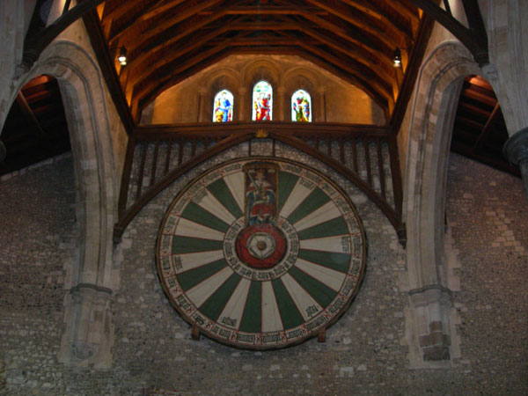
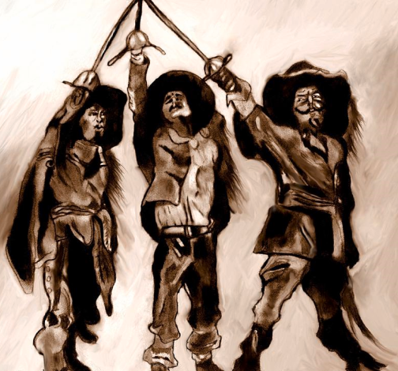
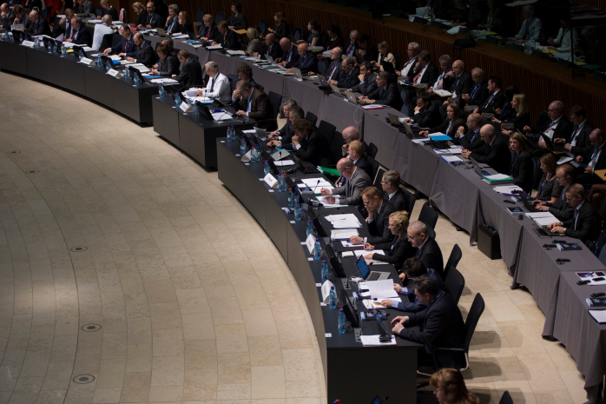
Why ?
Interactive session
Open the flow of free opinions
Moving from divergence to convergence
Looking for consensus
Aiming to reach the Specific Actionable Idea

Slide 5
Why Mentimeter?
Interactive sessions
Fairness and transparency
Measure audience’s mood
Building group identity
One Brain : Creativity = One Smart Device : Multi-Functionality

Slide 6
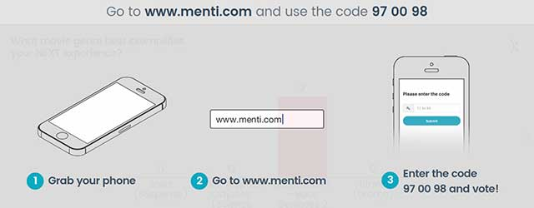
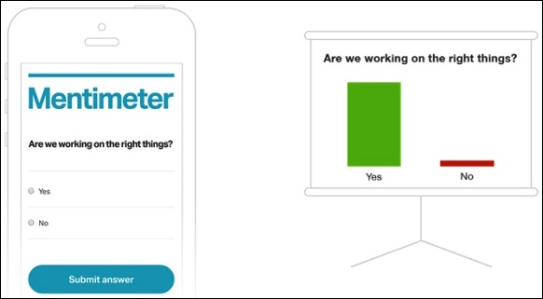
How to use Mentimeter
Participants:
Go to www.menti.com
Code is provide by the moderator
The code indicated below is just an example

Slide 7
Voting criteria
The attendees of the workshop will openly vote on the following questions:
Which pitch has the greatest potential for the advancement of Space Exploration?
Which pitch has the greatest market potential?
Which pitch has the highest value for the NEREUS network?

Slide 8
Pitching session -1
New material for clothes and shoes with anti-bacteria properties, L. Ravagnolo, ALTEC
Passive thermal solutions for manned space modules, F.Lepore, ARGOTEC
Bake In Space, S. Marcu, BakeinSpace
Vrtouch, E. Vezzoli, Go Touch VR
Portable on Orbit Printer 3D, G. Musso, Thales Alenia Space – Italia
ICE-Cubes, R. Aked, Space Applications Services
Space Pharma - remotely controlled lab, M. Aebi, Space Pharma

Slide 9
Pitching session -1
Kayser Italia. A. Donati, KI
BIOWYSE exploitation opportunities, V. Guarnieri, Thales Alenia Space – Italia
Manufacture cable harness to create a flexible and/or roll-able device, R. Lemsom, Thales Group NL
Online analyzer called CAMEO-A, F. Preud'homme, Qinetiq
PIUME - Portable Independent Utilities and Modules for Extreme conditions, G. Cecchini, Thales Alenia Space – Italia
EDEN ISS R.U.C.O.L.A. – Rack-like Unit for Consistent on-Orbit Leafy crops Availability, G. Boscheri, Thales Alenia Space – Italia
Xnext, P. Pozzi, Xnext srl

Slide 10
Pitching session - 2
Advanced transportation and robotic system for asteroids exploitation, F. Bandini, Thales Alenia Space – Italia
Recovery of small satellite platforms, A. Chiesa, AvioSpace
HYPLANE: The Future of Sub-orbital Space Access is Today, G. Russo, Trans-Tech srl
High Power Electric Propulsion Systems for Space Exploration, T. Misuri, SITAEL
Italian Spaceport, F. Santoro, ALTEC
ORBITECTURE: Study of a Multifunctional SpaceHub, G. Russo, Center for Near Space

Slide 11
Pitching session - 2
Space Park Leicester, M. Barstow, University of Leicester
Space Rider, F. Massobrio, Thales Alenia Space – Italia
Energy harvesting platform for remote monitoring networks, A. Iacchetti, Ribes Tech srl
MicroGen Renewables, M. Cowsill, MicroGen Renewables
Moon Village, P. Messina, ESA

