Slide 1
Fast and direct access to microgravity research
Alessandro Donati
General Manger, Kayser Italia
Category A – Direct Commercialisation of Exploration Outcomes
Workshop on “Commercialisation and Utilisation of Space Exploration Technologies”
Turin, 15-16 March 2018

Slide 2
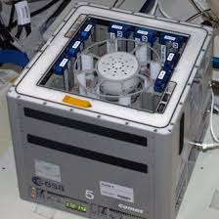
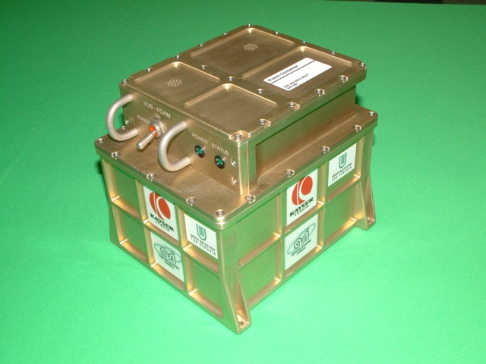
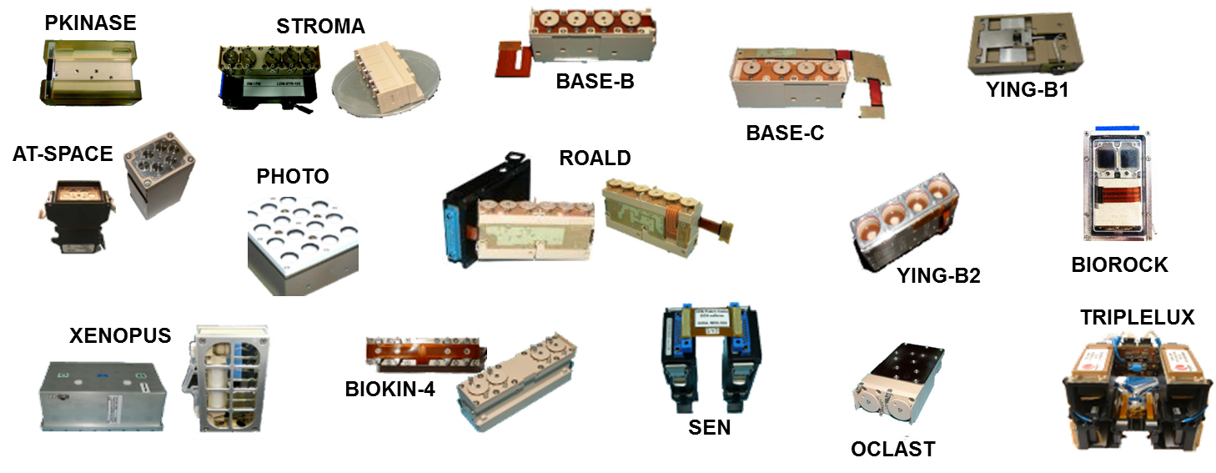
Category A – Direct Commercialisation of Exploration Outcomes
Challenge: access to microgravity research is limited, experiments are performed on ISS or orbital capsules, exploiting few existing on-board facilities or developing custom payloads → Little number of investigations performed
Solution: use of existing proven facilities, easy to accommodate and interface to the platform, together with experiment hardware equipment now available as standard products
Competitive advantage: reduction of time and cost for the preparation and execution of experiments, full service to customer (including flight ticket, support to launch, in-flight operations and sample recovery, if required)
http://www.kayser.it/index.php/catalog
Workshop on “Commercialisation and Utilisation of Space Exploration Technologies”
Turin, 15-16 March 2018

Slide 3
Category A – Direct Commercialisation of Exploration Outcomes
Research areas | Customer base
Biology Human Research Physical Science Fluid Physics Materials Science | Public research organizations Universities Healthcare structures
Biotechnology Protein crystals production Nanomaterials production and/or testing | Research centres Pharmaceutical industry Nanotechnology industry
Food Production & Preservation | Food industry
Plant Grow | Innovative agriculture industry
Technology demonstration | Space industry Technical research organizations
Education | Schools Universities Other educational organizations
Workshop on “Commercialisation and Utilisation of Space Exploration Technologies”
Turin, 15-16 March 2018

Slide 4
Category A – Direct Commercialisation of Exploration Outcomes
Development status:
The service and related products are available exploiting the ISS and some orbital capsules (e.g. Foton/Bion) as microgravity platforms
Envisaged enhancements:
Implementation on board new LEO platforms (e.g. Space Rider) and sub-orbital flights, by adapting the existing facilities and/or developing new ones. The standard experiment hardware (in the KI catalog) is used as it is.
Benefits for the citizens:
Research opportunities in microgravity to a greater extent, whose results can be applied to several application domains.
For instance, studying and understanding biology mechanisms related to gravity can introduce new therapies in the health sector.
Workshop on “Commercialisation and Utilisation of Space Exploration Technologies”
Turin, 15-16 March 2018

