Slide 1


space solutions®
Frank M. Salzgeber
Head of Technology Transfer Programme Office

Slide 2
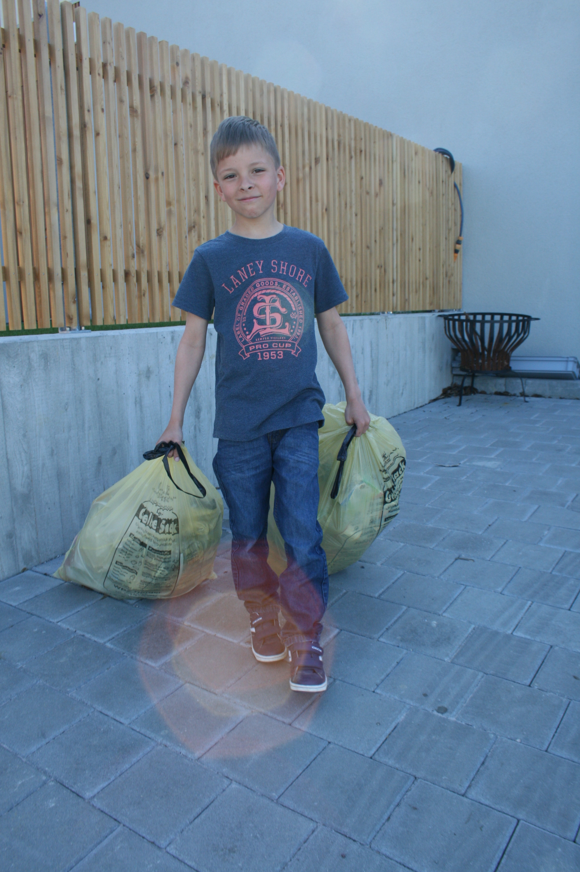
We recycle
We care
Notes:
16 tones material
Every person
Every year
6 become waste
10 are recycled reused…
Alos thanks to my son Lucas.
In Europe, we currently use 16 tonnes of material per person per year, of which 6 tonnes become waste. Although the management of that waste continues to improve in the EU, the European economy currently still loses a significant amount of potential 'secondary raw materials' such as metals, wood, glass, paper, plastics present waste streams. In 2010, total waste production in the EU amounted to 2,5 billion tons. From this total only a limited (albeit increasing) share (36%) was recycled, with the rest was landfilled or burned, of which some 600 million tons could be recycled or reused.

Slide 3
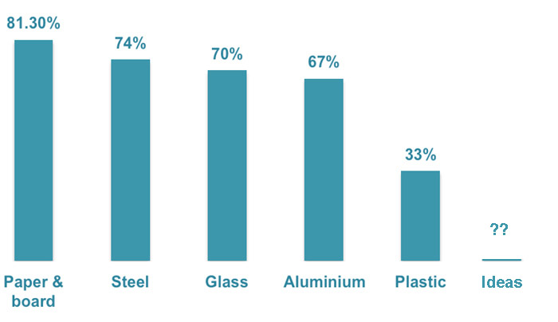
We recycle
We care

Slide 4
We recycle
We don’t care
Notes:
2007 to 2013 FP7 50 Billion in research and development last 7 years
Apple R&D bud 4,5 Billion $
The FP7 portfolio consists of over 90 R&D projects, all creating economic value and developing a GNSS capacity in Europe amongst 425 beneficiaries. In particular, SMEs have been increasing their involvement in each of three FP7 calls, accounting for 40% of all participants in GNSS FP7 projects. 16 patents?

Slide 5

Notes:
Students homes
Fridge
Omlet without eggs,
Confrlaces without milk and spagellti without paste….
Some delicious meals and some really special ones.

Slide 6
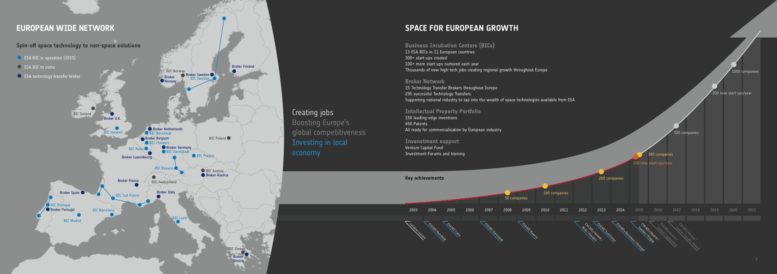
ESA space solutions European network
Space solutions

Slide 7
ESA space solutions European network
Space solutions

Slide 8
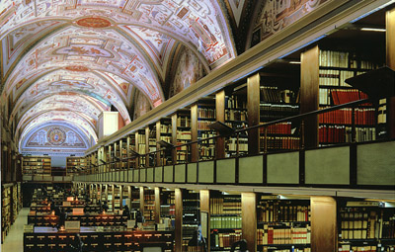
Store History
One of over 300 spin-offs
ESA has supported
Notes:
FITS’, the flexible image transport system format, stemming from radio astronomy. FITS is now used to store data from many space missions.
Star images helping to save Vatican books
19 December 2011
Antique books in the Vatican Library are being digitised to preserve them for future generations using a technique developed through ESA to store satellite images of the sky.
The Library needed a way of scanning the delicate old manuscripts and storing the files so that they could still be read in hundreds of years. The answer was the special file format used by ESA for most of its scientific satellites.
Andromeda Galaxy in infrared and X-rays
In the 1970s ESA and NASA scientists developed ‘FITS’, the flexible image transport system format, stemming from radio astronomy. FITS is now used to store data from many space missions.
“Any kind of data you can use for astronomy can fit inside this format,” says Pedro Osuna, Head of ESA’s scientific archives.
That made it ESA’s top choice for storing the mountains of information from almost all of the agency’s astronomy missions. The pioneering Herschel, Integral, XMM-Newton and SOHO space observatories all use it.
In this digital era, finding a storage format for the ages is a big challenge facing researchers, archivists and librarians the world over. FITS is the answer.
“If you have a tool that can read FITS today, you can read FITS files from 20 years ago,” Mr Osuna says. “It’s always backwards compatible.”
Vatican bookBringing ancient books to future generations
Today, the format developed to save images of the stars is being tailored for a very different purpose: preserving one of the world’s largest collections of ancient books.
“Most space missions, like the Hubble Space Telescope, use FITS to store and study scientific data,” says Giuseppe Di Persio of Italy’s National Institute for Astrophysics.
Dr Di Persio is now working with the Vatican Library in Rome on a pilot project to scan part of its massive collection, saving it as FITS files to make sure they are available to future generations.
Founded in 1475 and one of the world’s oldest libraries, the Vatican Library houses tens of thousands of manuscripts and codices from before the invention of the printing press – some are 1800 years old.
Scanning old booksIn addition to making the contents more accessible, digitising will help to preserve the originals.
“It’s very dangerous for the manuscripts every time someone touches them,” says Luciano Ammenti, Director of the Vatican’s Information Technology Center, spearheading the project.
He chose FITS because of its longevity and also because it is open source – not linked to any one company.
The format also lends itself to the fragile, ancient tomes in the Vatican’s collection. Pressed against a plate of glass, the old pages can be distorted, but scanner software developed for the project automatically calculates the different angles, resulting in an accurate, flat image.
Sun seen by SOHO
Images stored in FITSThe secret of the format is that the instructions needed to read and process the data are in a text header tacked on top of the data. In a century, when computers will presumably be very different, that means all the information needed to decode them is in the same files.
FITS can always be read without the need for conversion to another format, which could lose information or be incompatible with future systems.
As Dr Di Persio says: “Once FITS, always FITS.”

Slide 9






THE space innovation network in Europe …
The global innovation competition for satellite navigation
The global innovation competition for
earth observation services
The European approach for developers to use the European space programmes
ESA BICs and Space Solution Centers

Slide 10

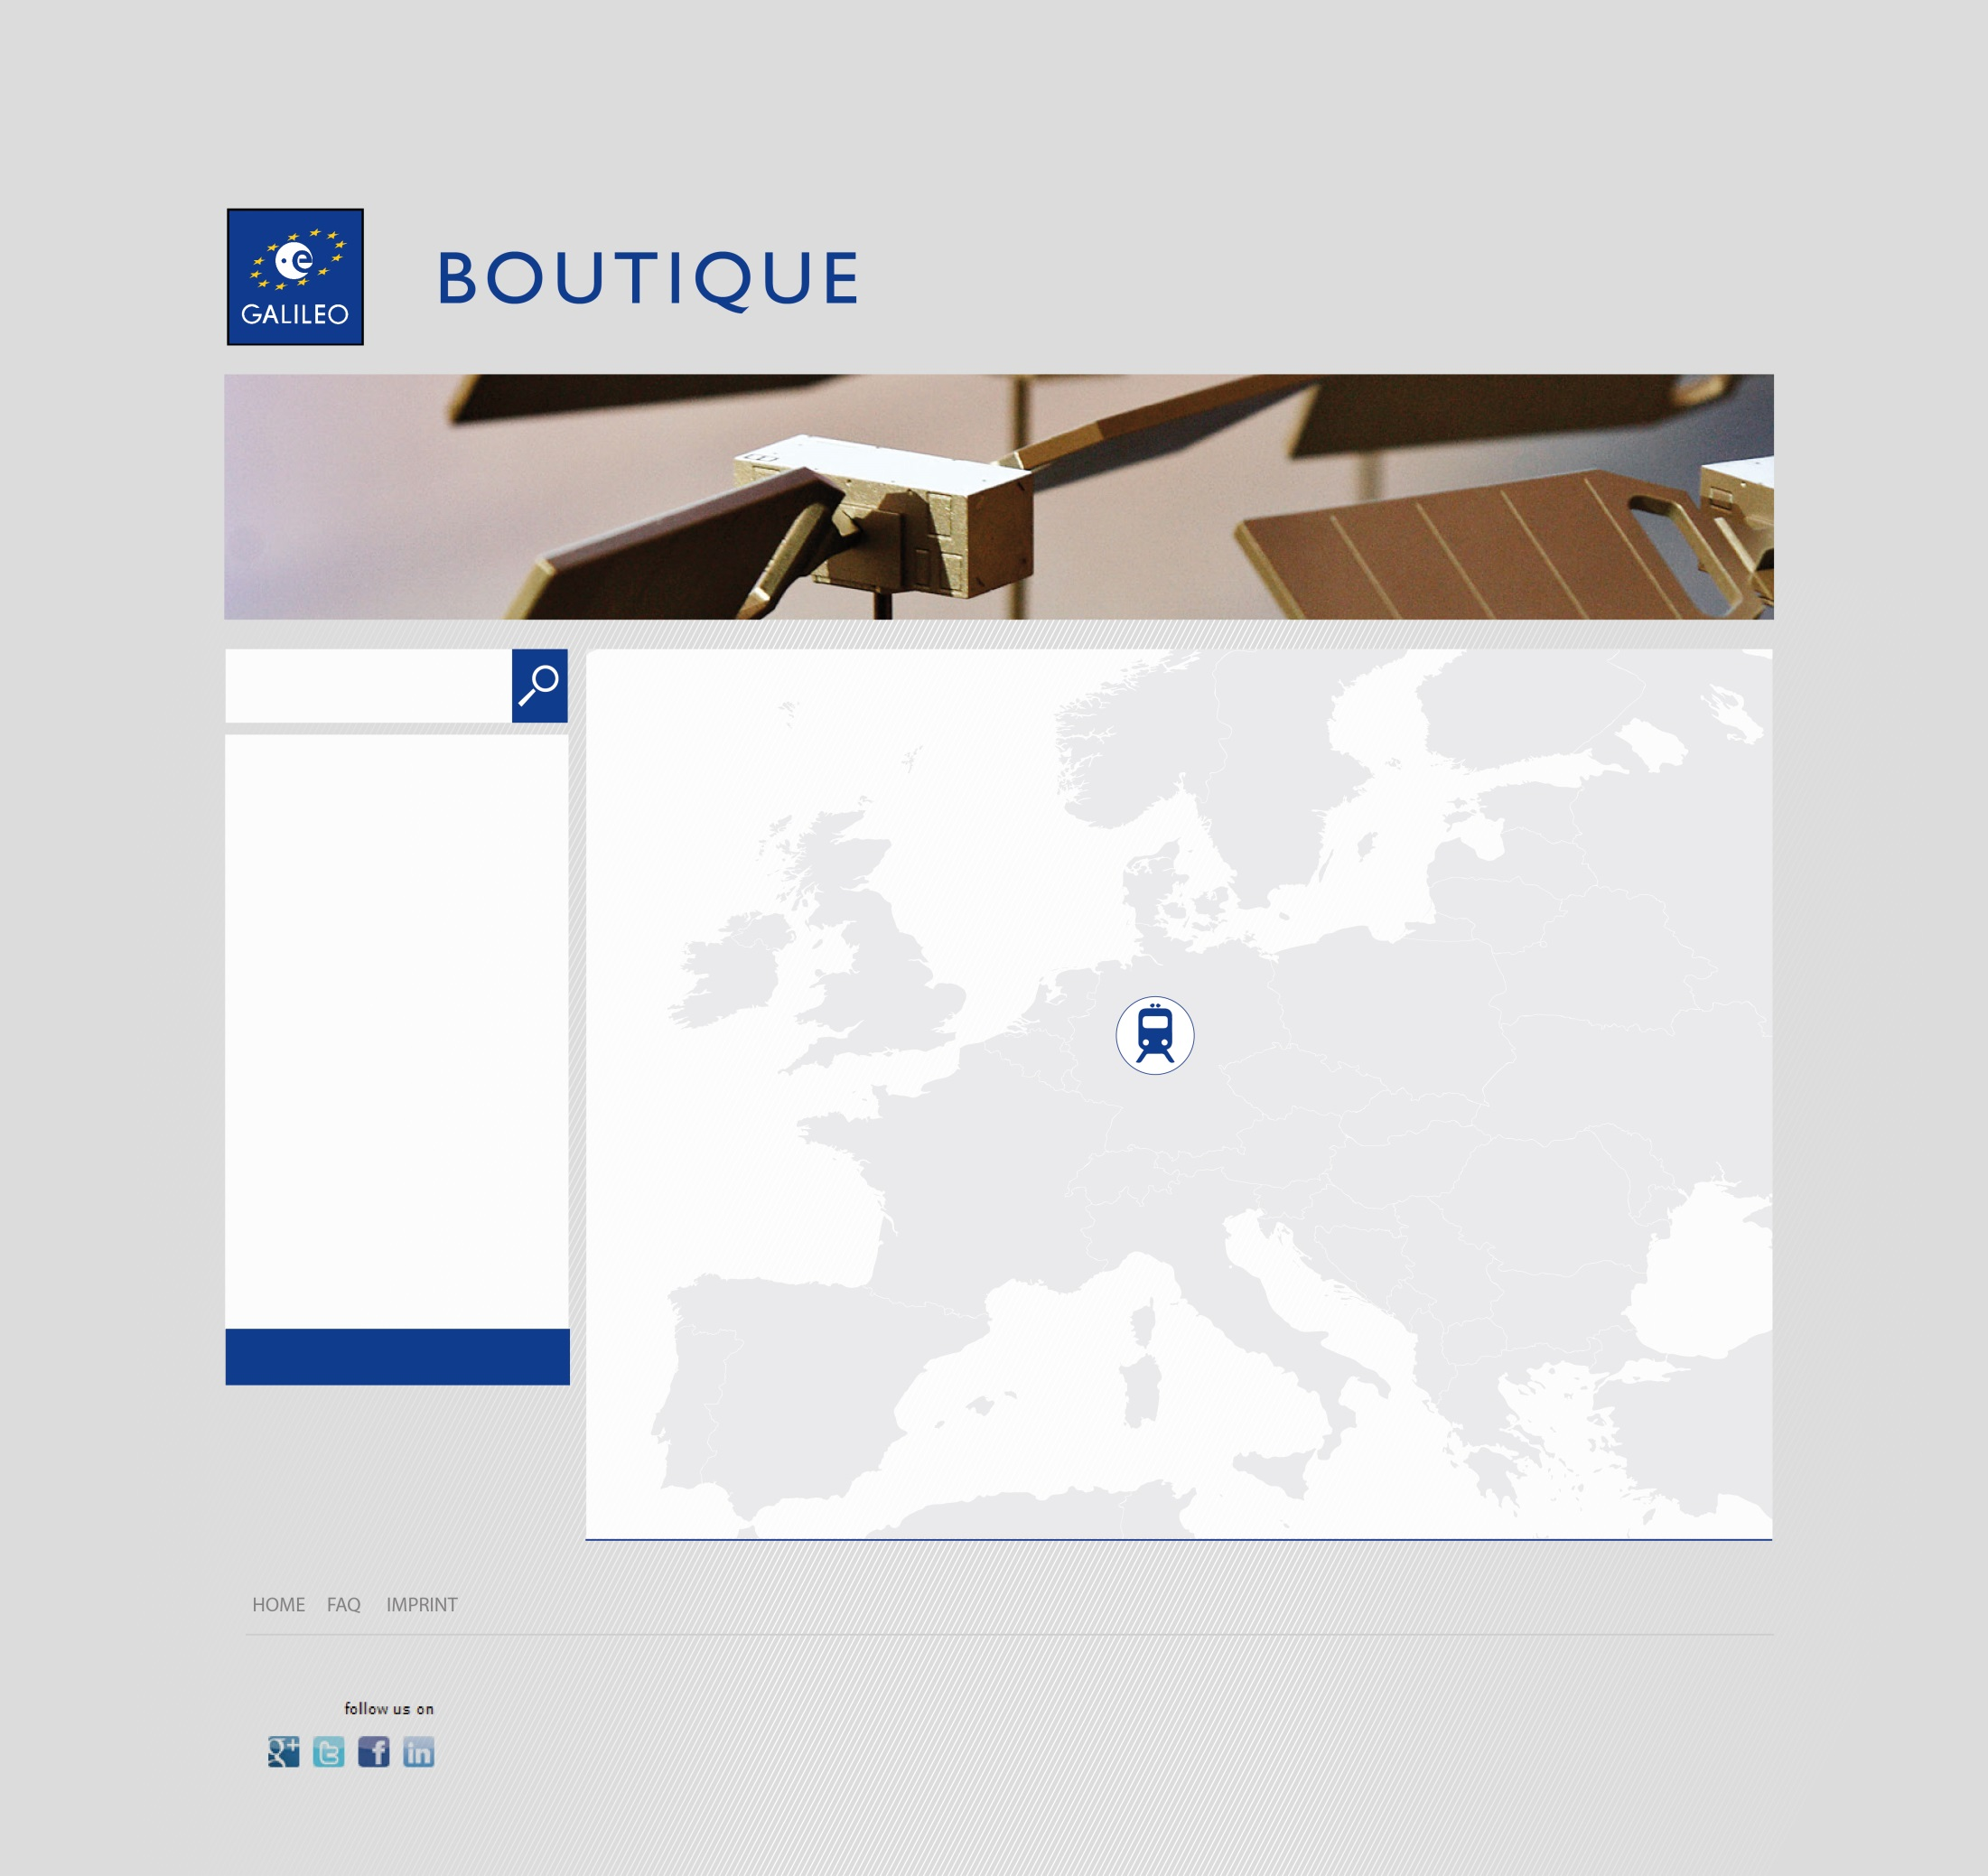

Search
Train collision avoidance system
Company:
Intelligence on Wheels
Implemented:
Harzer Schmalspurbahn
more
RAIL

Slide 11
1
Notes:
Image from mars express

Slide 12
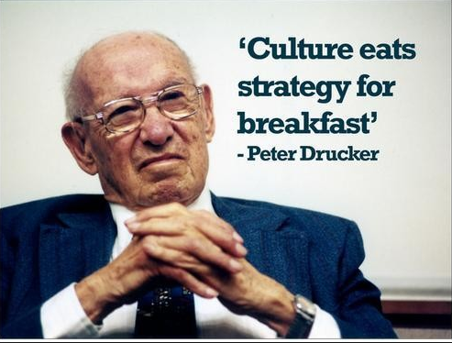
Notes:
Image from mars express

Slide 13

Kill Zombie companies
Notes:
Image from mars express

Slide 14

Incubation vs. Intubation

Slide 15

What is the plan B?
Notes:
The bee will fly to the light!
It goes to the Sun in emergency, it is in its DNA
In companies we have the same,
IF you do not have a plan B you may die

Slide 16
2
Notes:
Image from mars express

Slide 17

Time is money
Notes:
These are 5 of the neary 100 mimilion people under 30 years are searching for a job
Benetton will help 100 of them!
OR THEY WANT TO BECOME ENTERPENREURT

Slide 18
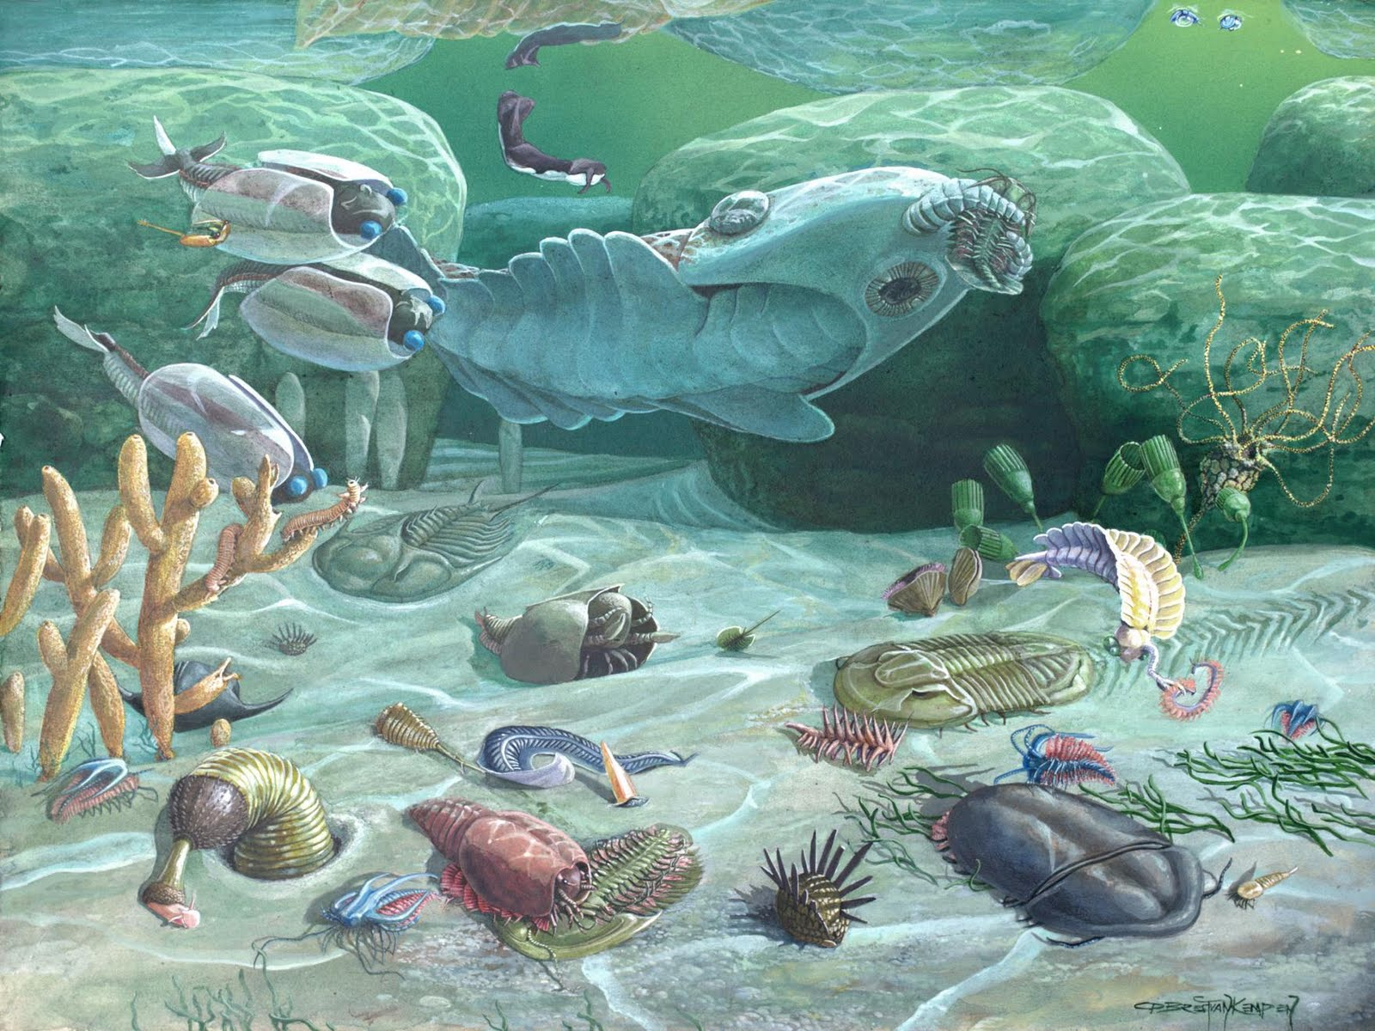
The Cambrian explosion
….of start-ups
Time is money
Invest in seed
Notes:
he Cambrian explosion, or Cambrian radiation, was the relatively rapid appearance, around 542 million years ago, of most major animal phyla, as demonstrated in the fossil record.[1][2] This was accompanied by major diversification of other organisms.[note 1] Before about 580 million years ago,[note 2] most organisms were simple, composed of individual cells occasionally organized into colonies. Over the following 70 or 80 million years, the rate of evolution accelerated by an order of magnitude[note 3] and the diversity of life began to resemble that of today.[5] Ancestors of many of the present phyla appeared during this period,[6][7] with the exception of Bryozoa, which made its earliest known appearance in the Lower Ordovician.[8]
The Cambrian explosion has generated extensive scientific debate. The seemingly rapid appearance of fossils in the “Primordial Strata” was noted as early as the 1840s,[9] and in 1859 Charles Darwin discussed it as one of the main objections that could be made against his theory of evolution by natural selection.[10] The long-running puzzlement about the appearance of the Cambrian fauna, seemingly abruptly and from nowhere, centers on three key points: whether there really was a mass diversification of complex organisms over a relatively short period of time during the early Cambrian; what might have caused such rapid change; and what it would imply about the origin and evolution of animals. Interpretation is difficult due to a limited supply of evidence, based mainly on an incomplete fossil record and chemical signatures remaining in Cambrian rocks.

Slide 19

Invest in seed
Time is money

Slide 20
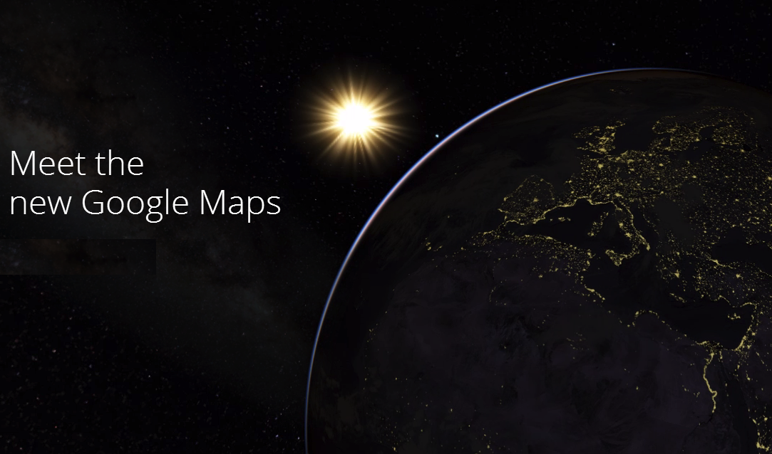
Space solutions
frank.salzgeber@esa.int
www.esa.int/bic
www.esa.int/ttp
Time is money
Cipy maps
Notes:
Nearly 20 Bil.$ investment
TomTom with Teleatlas as disapeered, Open Streetmap as joined Noka! There are only 2 left Goggle and Nokia,
Investing 1 to 3 Billion a year
Online-Kartendienst "Waze” for 1.1 Bilion $
The big fight of the centure
Monopol,
Waze!!
New York - Facebook galt lange als wahrscheinlicher Käufer - doch nun macht offenbar Google das Rennen um den Online-Kartendienst "Waze". Der Internetkonzern wolle rund 1,1 Milliarden Dollar bezahlen, Juni
Zusatzdienste, die auf Smartphones oder Tablets genutzt werden können, werden für Tech-Konzerne wie Google und Facebook immer wichtiger. Denn mit ihnen steigt auch die Nutzung von mobilen Geräten und damit die potentiellen Werbeeinnahmen, die über sie generiert werden können.
"Waze" verwendet die Satellitensignale der Smartphones, um den Nutzern Karten- und Verkehrsdaten in Echtzeit zur Verfügung zu stellen. Der Dienst funktioniert zugleich wie eine Art Onlinenetzwerk für Autofahrer. Sie informieren sich untereinander über Staus, Unfälle oder Radarfallen.
Das erst vor vier Jahren in Israel gegründete Unternehmen hat 47 Millionen Mitglieder und 100 Mitarbeiter. Inzwischen hat die Firma ihren offiziellen Sitz nach Kalifornien verlagert. Die App ist kostenlos. Geld kommt durch Werbung und den Verkauf von Kartendaten rein.
Dem "Wall Street Journal" zufolge könnte "Waze" unter dem Dach von Google weiter unabhängig agieren, während einige Informationen zugleich in den Kartendienst des Internetriesen integriert werden würden.

