Slide 1
The dimension of space in Lombardy’s S3 strategy
SPACE4Growth and Jobs: The role of regional policies and programs
Brussels, 28 May 2015

Slide 2
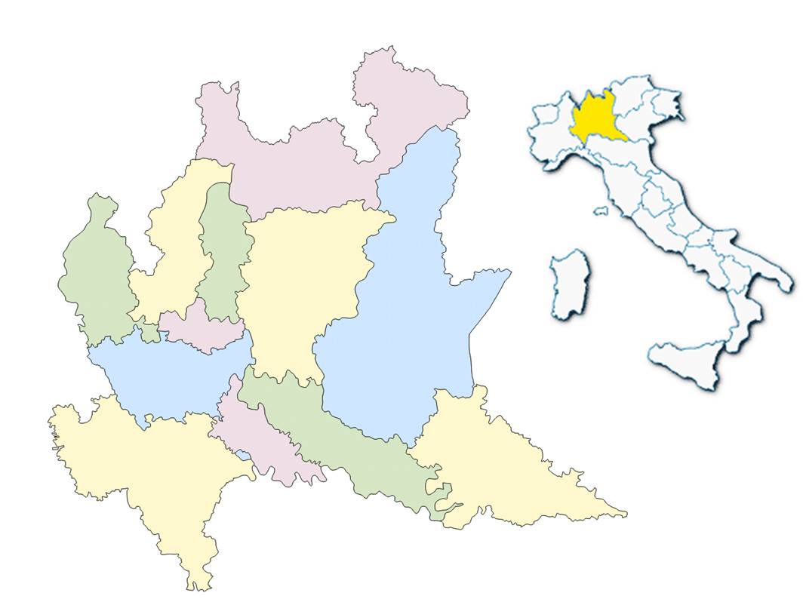
Lombardia in a nutshell
Surface area: 23,836 km²
Resident population: 9.973.397
GDP 331.405 million euro
952.013 companies (mainly SMEs)
14 universities offering the whole spectrum of academic education – 275.899 students earning high-school diplomas
an extended public and private research systems
Lombardy in Italy …
Surface area: 7.9 %
Population: 16.8 %
Population density: +2.07 times
GdP: 20.4%
Source: processing of ISTAT data 2014

Slide 3
The baseline …
A policy mix combining
top down and bottom up
approaches to support
the emerge of the
regional vocations and assets
16 industrial districts (geographical proximity and sectorial specialisation)
5 metadistricts (value chain integration to foster manufacturing excellence)
a process of identification of 10 priority technology sectors supported through competitive call for industrial research among which ICT
Stakeholders consultation (December 2011) on 7 industrial strategic domains (December 2001): involving 3347 research organisations and companies

Slide 4
Towards a smart specialisation in Lombardia
Regione Lombardia adopted in 2011 a more strategic oriented approach aimed to channel the regional competences, know-how and
spontaneous networks towards technological clusters on strategic domain in line with the national cluster framework
9 regional clusters :
AEROSPACE, AGRI-FOOD, ECO-INDUSTRY, HEALTH INDUSTRY, CREATIVE AND CULTURAL INDUSTRIES, ADVANCED MANUFACTURING,
SUSTAINABLE MOBILITY

Slide 5
Regione Lombardia’s RIS3 … current status
The Lombardia‘s RIS3 was approved in December 2013 (DGR 1051/2013).
The implementation phase started in 2014.
The last update was in April 2015 (DGR 3486/2015).

Slide 6
Regione Lombardia’s RIS3..
main areas of action
Initiatives for KETs development
Initiatives for innovation demand orientations
Initiatives to promote cross-fertilization
Support instruments for eco and social innovation
First actions:
Set up of thematic communities in the framework of Open Innovation Platform and Cluster Initiative – October 2014
Direct business R&D support (FRIM ERDF 2020)* - December 2014
* Research, development and innovation projects should address specialization areas identified by the
"Regional Strategy of Smart Specialization for Research and Innovation (S3)"

Slide 7
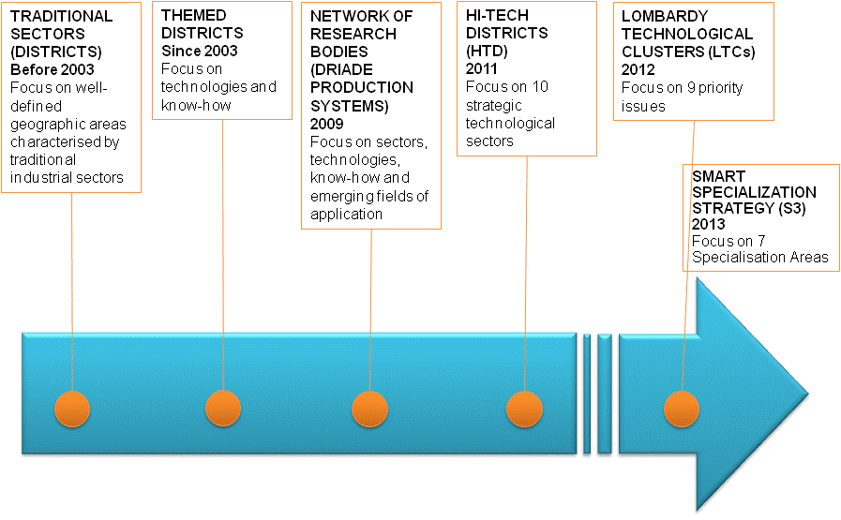
Regione Lombardia’s RIS3 … priorities
Regional priorities (definition and transformation)
From vertical specialization approach to horizontal
specialization “system of competences” approach
In practice:
Specialization Areas (SA):
Aerospace
Agrofood
Sustainable Mobility
Eco Industries
Advanced Manufacturing
Health Industries
Creative and Cultural Industries

Slide 8
AEROSPACE … one of the 7 specialisation areas
For each specialisation areas in October 2014 we have approved the work programs with the declination in macro thematic and, for each of them, outlines the most relevant enabling technologies, materials and methods that are necessary to face our RIS3's challenges: for instance, space integrated systems and space systems, fixed and mobile wing integrated aeronautical systems, electro-mechanical systems and avionics, nano electronics and photonics

Slide 9
AEROSPACE : european benchmarking
Cluster | enterprises | employees | Universities and Research cnters
Cluster Aerospazio Lombardo | 185 | 15.000 | 10
Aerospace Valley | 60 Industries and 260 SMEs | 115.000 | 17
ASTech Paris Region | 220 | 230.000 | 39
Pôle Pégase | 160 PMI | 20.000 | 30
Baden-Württemberg | 60 | 15.000 | 10
Hamburg Aviation | 3 Industries and 300 SMEs | 39.000 | 8
Aerospace Initiative Saxony | 135 | 5.600 | 30
Aviabelt | 42 i | 20.000 | 5
bavAIRia | 550 | 61.000 | 17
Berlin-Brandenburg Aerospace Alliance | 4 iIndustries and 100 SMEs | 17.000 | 25
Hanse Aerospace | 160 | 14.000 | 9
Niedersachsen Aviation | 250 | 30.000 | 14
Fonte: EACP – European Aerospace Cluster Partnership

Slide 10
AEROSPACE : what has already been done
MoU between Lombardy Region and Italian Minister for Research and Education(dicember 2010)
Joint call - 2011 to submit R&D projects, in particular 10 M euros for aerospace sector;
MoU between Lombardy Region and Italian Research Center (CNR) (July 2012)
On going joint project “SPACE4AGRI” (budget 1.374.750,00).

Slide 11
Leonardo Lorusso
Lombardy Region Delegation to the EU
Tel +32 2 518 7600
Fax +32 2 518 7626
leonardo_lorusso@regione.lombardia.it
2, place du Champ de Mars
1050 - Bruxelles

